Slide 1
WG1 Meeting Munich 2017-12-07 The What, Why, How of Deep Neural Networks and Location FTS

Slide 2
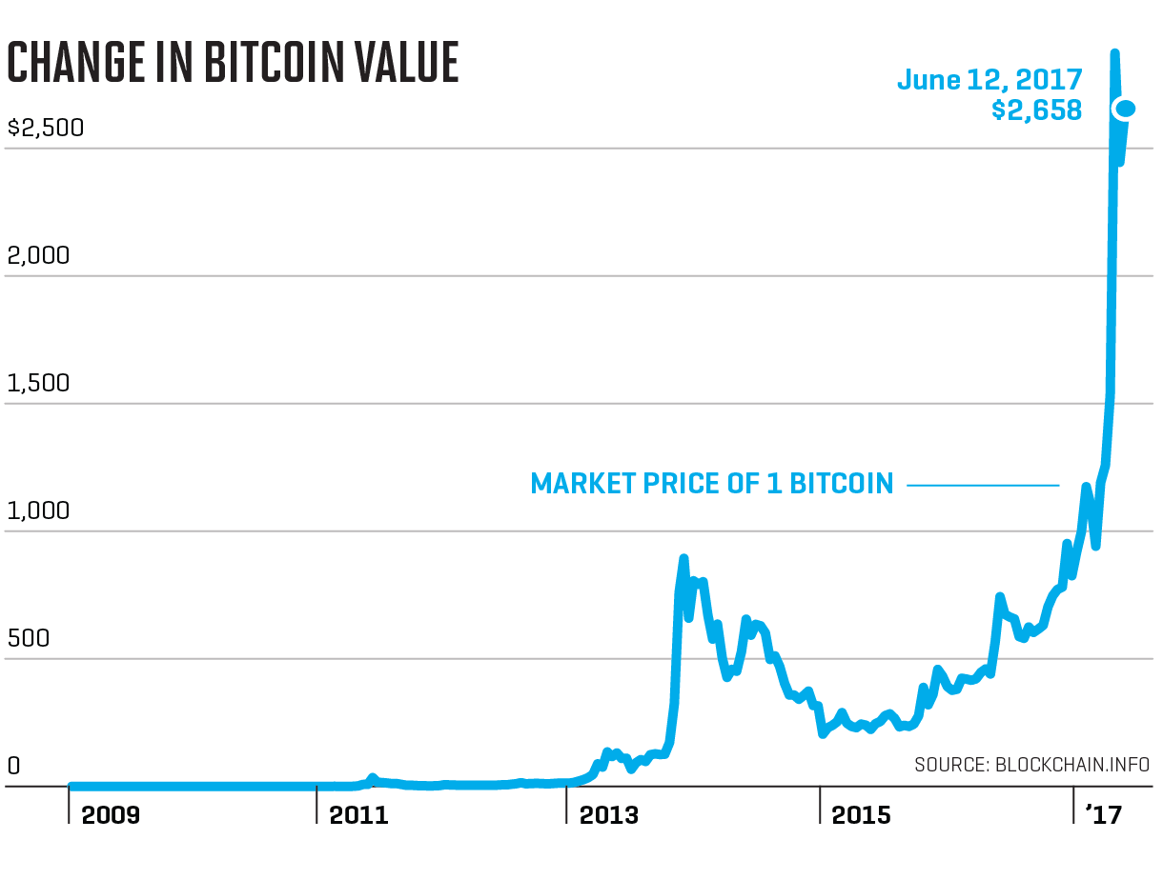
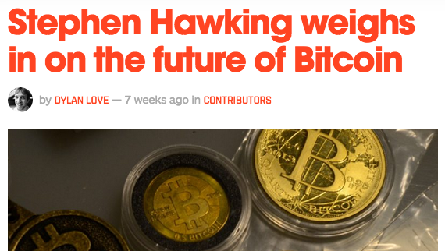
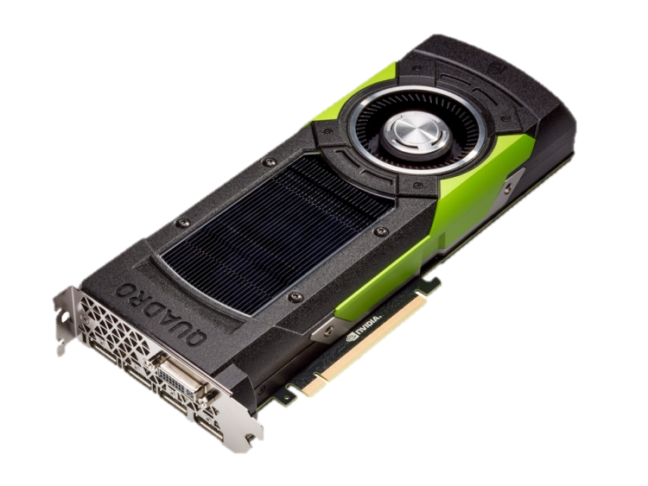

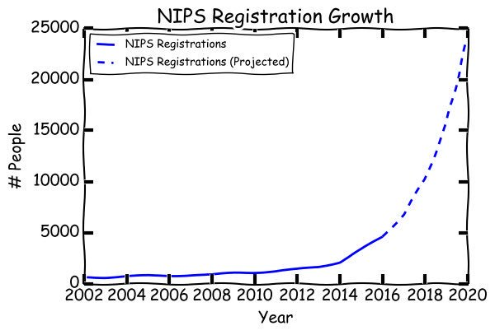
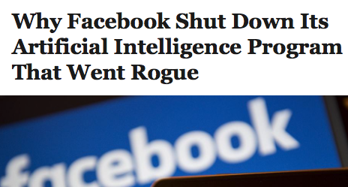
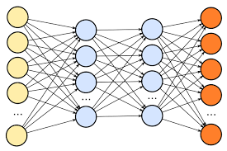
Being reasonable about Neural Networks
Bitcoin
Neural
Networks

Slide 3
Being reasonable about Neural Networks
Exaggerated, but:
Traditional methods often disregarded unfairly
(Random Forest/Naïve Bayes/SVM/HMM/CRF/…)
Hype must be separated from reality
DNNs are sufficient for all ML problems.
There are standard NN approaches emerging now. ("Software 2.0”)
This must be appreciated.

Slide 4
Introduction
What's the problem?
Predictive location/address search
Map user query string to list of tuples of addresses:
"mai illiniss west chicoka u”
{road: May St, city: West Chicago, state: Illinois, country: United States..., docid: xx}
Error at any stage has catastrophic consequences for prediction/retrieval!
Classification
Completion
Spellcheck
FTS
Match

Slide 5
Introduction
What data are we working with?
Road FTS North America database with full road coverage
Using classification of COUNTRY, STATE, CITY, ROAD
About 44,000 cities and total of 9,448,382 roads

Slide 6
Introduction
How do we model artificial queries?
For benchmarking, training (later)
Probabilistic query grammar
Artificial string corruption
Optional constrained replaces
Keyboard distance
Phonetic distance

Slide 7
Introduction
What’s to miss with FTS-5?
Priorities are only measure to constrain suggestion ranking
Tokens are not related to each other → Context has no influence on suggestion
Term | Occurences
10th | 10.000
new | 1000
york | 50
main | 800
st | 100.000
… | …
St L[ouis] | vs | St Loui[siana] | ➞ Subtoken violation
California Los A[ngeles] | vs | California Los A[lamos] | ➞ Hierarchy violation
Virginia V[ictoria] | vs | Virginia V[irginia] | ➞ Redundancy violation

Slide 8
Introduction
What’s to miss with Sqlite Spellfix?
Sqlite Spellfix creates an index of phonetic spelling buckets over tokens
Can only correct phonetic misspellings → most deletions/insertions will not be corrected, e.g.:
neu york -> new york works
nex york -> new york fails

Slide 9
Introduction
What's the very best we could do without NNs?
Symspell
Don‘t lookup every differently spelled token version
Don‘t save every misspelled token version
The Symmetric Delete spelling correction algorithm: Save deletions in database up to a certain distance, Make lookups up to certain distance
Number of additional lookup entries per token is …
x=n!/d!/(n-d)!
(n=14,d=2): x=n*(n-1)/2=91
4.5M unique tokens * (91+1) = 414M index entries
at least 5.8 GB (w/o metadata, references uncompressed)
(n=14,d=1): x=n=14
4.5M unique tokens * (14+1) = 68M index entries
at least 960 MB
Input | Database
nwe york | new york
we york | ne york
ne york | nw york
nw york | newyork
… | …

Slide 10
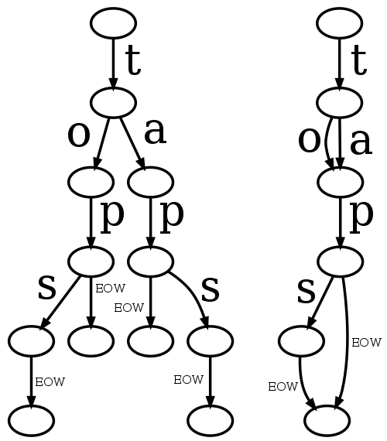
Introduction
What's the very best we could do without NNs?
Best compressed string lookup structure:
DAWG
Compress strings not just as Tree, but as Directed Acyclic Graph (Automaton)
Useful for Tokenization, Spellcheck, Completion
2.2 GB index for d=2
670 MB for d=1
30 MB for d=0 (poor spellcheck)

Slide 11
Introduction
What could be achieved with NNs?
Reduce total index+model size to 150 MB
without loss of spellcheck performance.

Slide 12
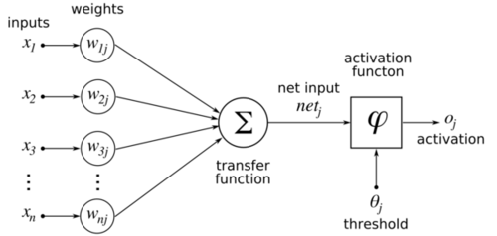
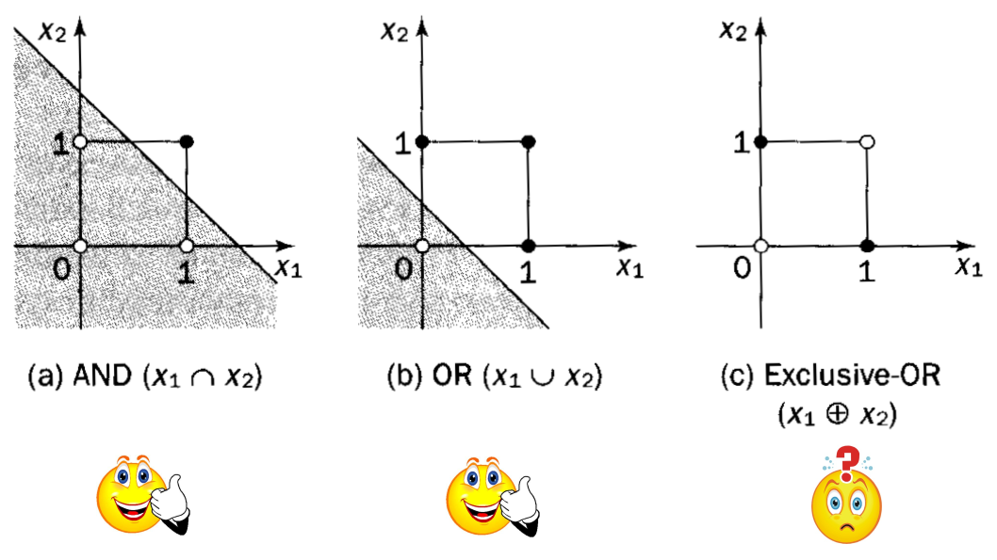
Neural Network Basics
1950s:
Perceptrons
Gradient descent
XOR-Problem

Slide 13
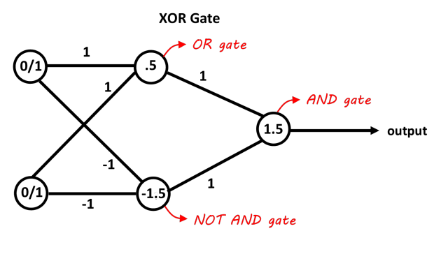
Neural Network Basics
1980s:
Geoffrey Hinton:
Hidden Neuron Layers, Backpropagation of Error
XOR-Problem solved:

Slide 14
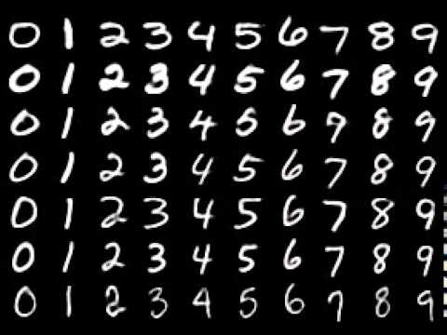
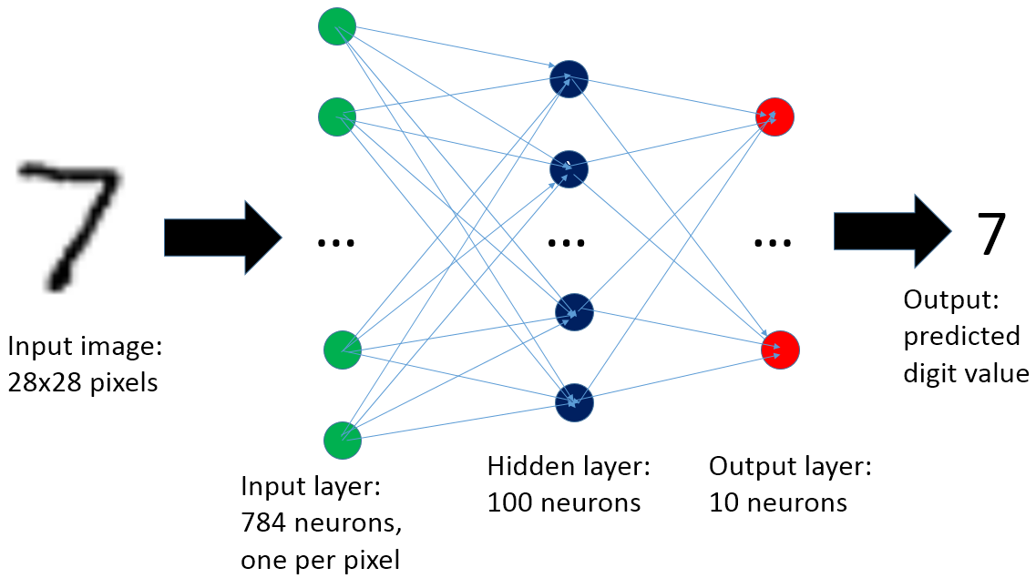
Neural Network Basics
Character recognition
NIST (National Institute of Standards and Technology) published MNIST dataset for recognition of digits
28*28 pixels greyscale = 784 features per character

Slide 15
Neural Network Basics
Character autoencoding (2006)
Compress 784 dimensions to 2 dimensions

Slide 16
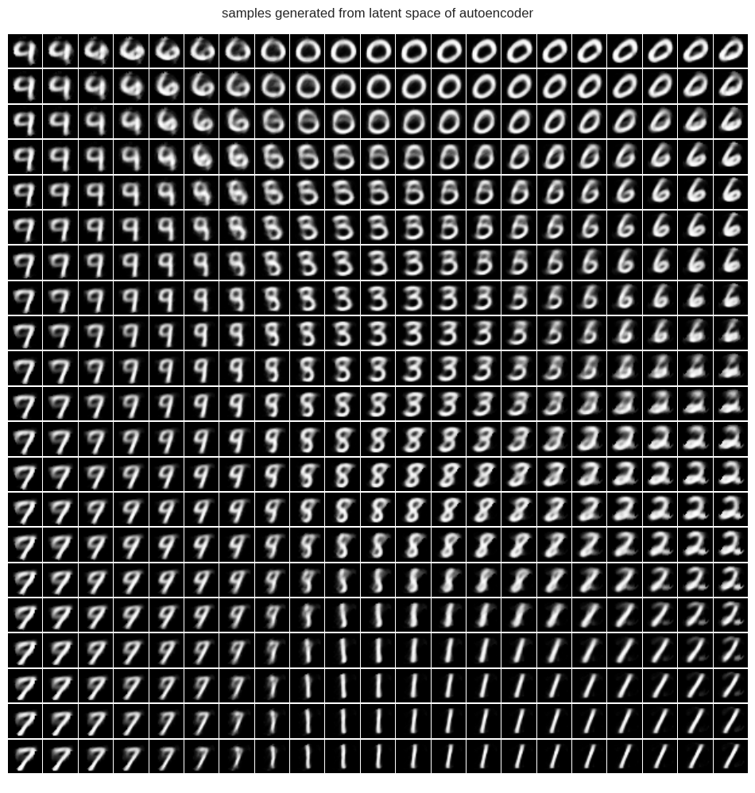
Neural Network Basics

Slide 17
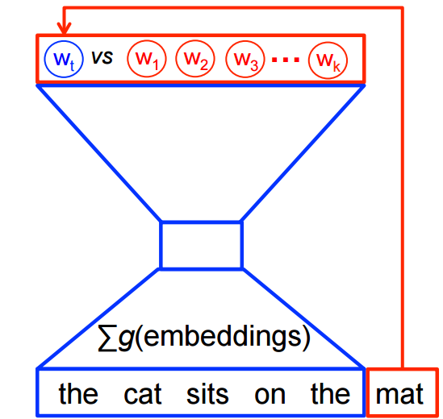

Neural Network Basics
Word2Vec (2013)
Let neural network autoencode the context of a word
Prediction of next word → Backprop.
Hidden Layer
(Encoded word vector)
Input context

Slide 18
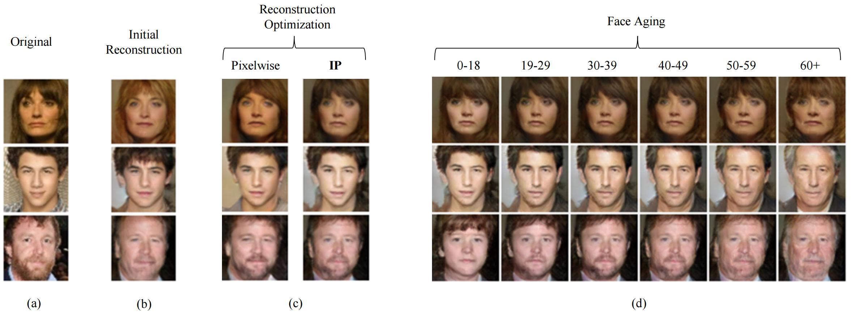
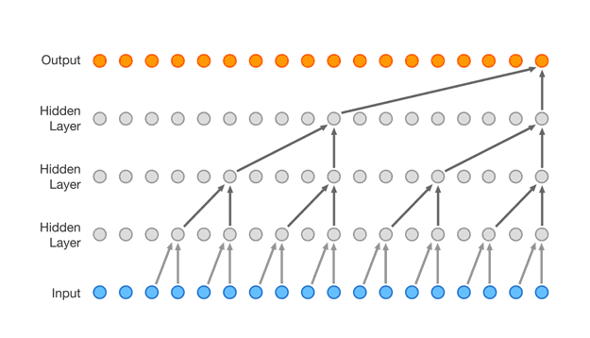
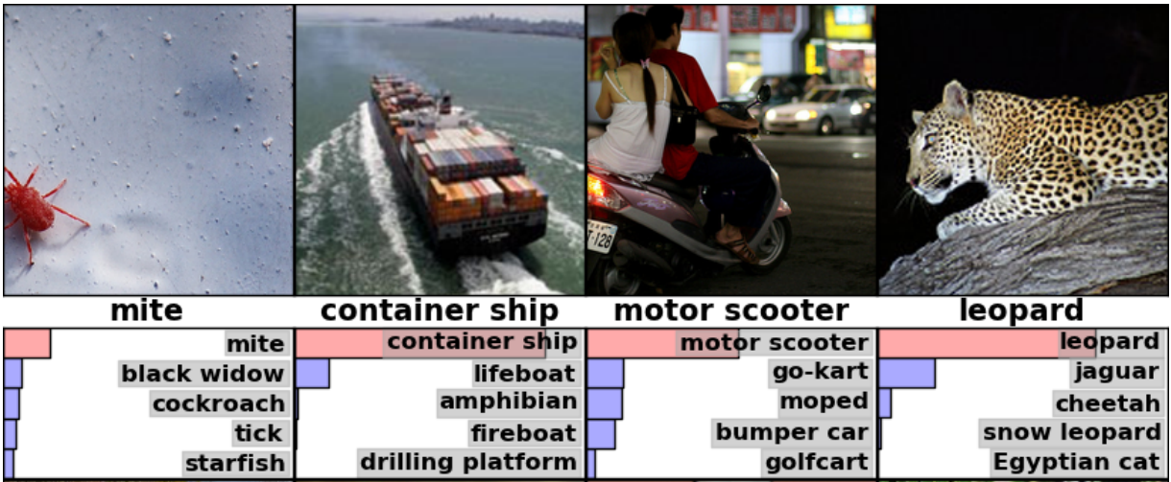
Neural Network Basics
Since then:
Conv. Nets for Computer Vision (Inception)
Speech (WaveNet)
Generative Adverserial Networks (GANs)
Use-cases:
Classification
Autoencoding
Generation
"... but for strings!"

Slide 19
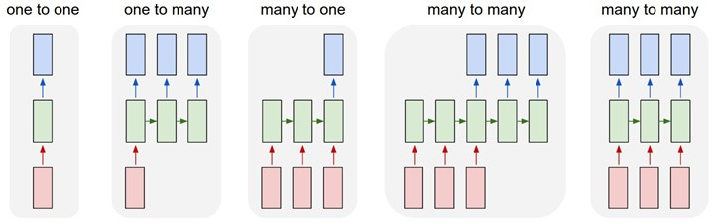

Neural Network Basics
Neural Networks for Sequences:
Recurrent Neural Networks
Completion
Autoencoding
Classification

Slide 20
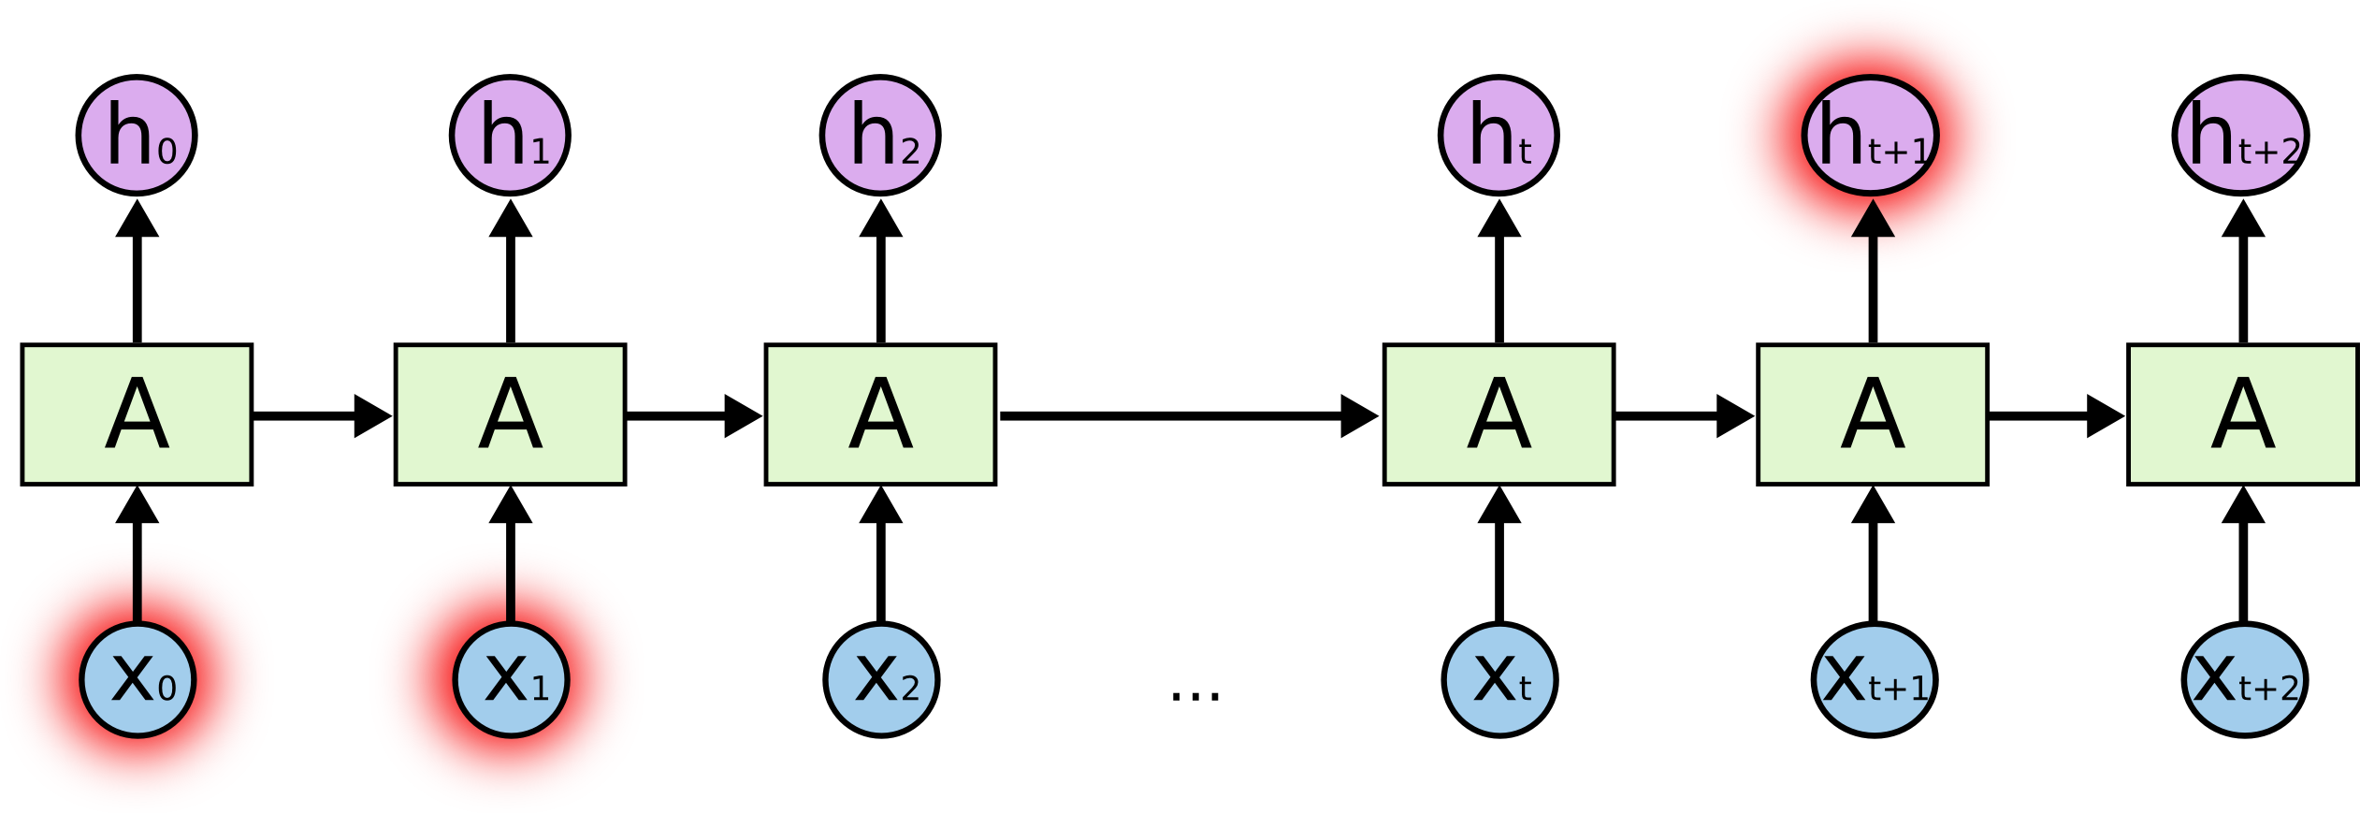
Neural Network Basics
Smart people say that RNN is Turing complete
But: They are very hard to train
suffer from „diminishing gradient problem“

Slide 21

Neural Network Basics
Solution:
Sepp Hochreiter & Jürgen Schmidhuber
TU München 1999
„Long Short-Term Memory“
Now de-facto „standard model“ in ML for sequences

Slide 22
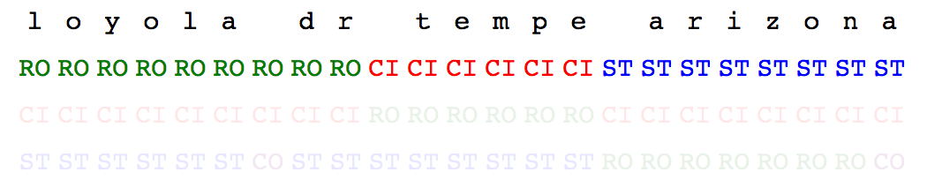
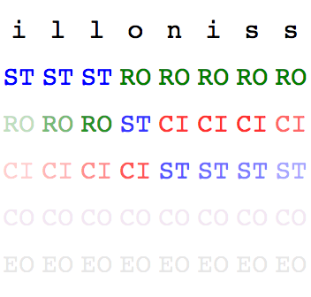
Neural Network Basics
Classification & Tokenization with LSTMs:
Usually the network is very sure of what it does
Sometimes it‘s confused:
But in SUM still a „state“!
Generalizes from spell errors without explicit training!

Slide 23




Neural Network Basics
Completion with LSTMs:
User
Query String
“California Palo A”
Step 1: Categorization Network (Discriminator)
Step 2: Prediction Network (Extrapolator)
[“California”]_{STATE} [“Palo A”]_{CITY}
C
a
l
i
f
o
r
n
i
a
P
a
l
o
A
First, read prefix characters and their categories….
l
t
o
…
…then predict completion!
Ranked character/class predictions per timestep

Slide 24
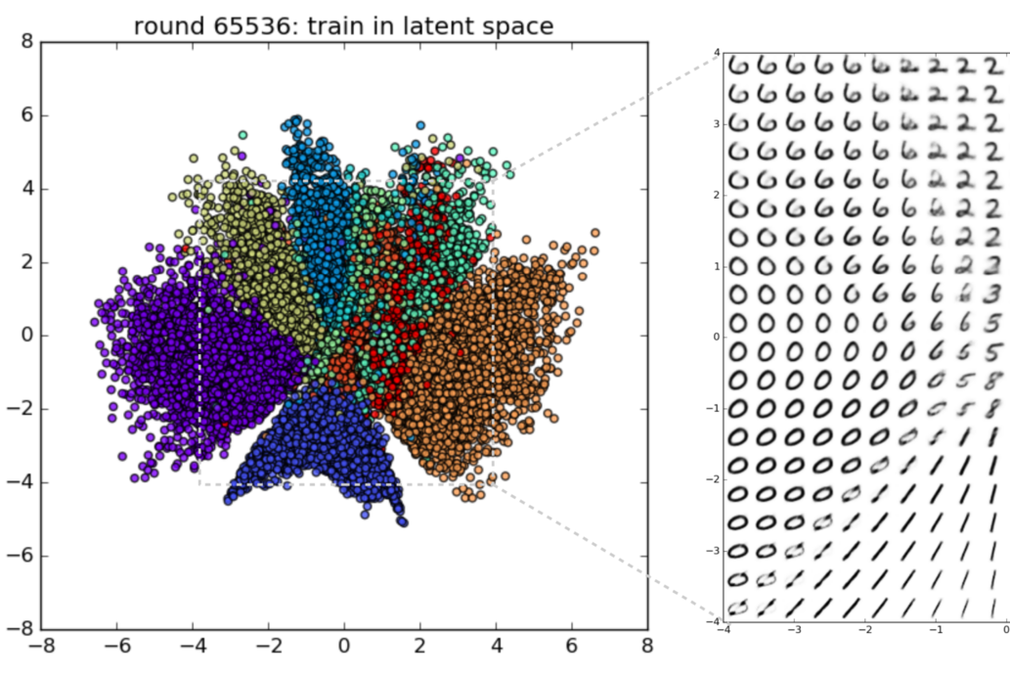
Neural Network Basics
Spellchecking with LSTMs:
NNs (“Autoencoders”) are really good at creating low-dimensional hashes of objects (images, text).
Idea: Let NN encode (hash) user input, find match-suggestions from nearest neighbors (kNN/k-d Tree).

Slide 25
Neural Network Basics
User String
Deep Spell Stack
Classifier (city, state, road, etc.)
2 MB
Completer (string based on category)
5 MB
Corrector (corrects mistakes)
10 MB
KD tree
130 MB
FTS DB
FTS DB
800 MB
(340 MB content table)
NamedObject ID

Slide 26
Neural Network Basics
Correctness of top three suggestions for NN/FTS5 per prefix length:

Slide 27
Neural Network Basics
Correctness of spellchecker:
symspell max_distance=2/2 (model_data=2.1GB)
corr=0.9980556183585801%
symspell max_distance=1/1 (model_data=611MB)
corr=0.9518878589192855%
symspell max_distance=0/2 (model_data=32MB)
corr=0.8888311101062627%
Deepspell (150MB):
corr=0.9630002260908885%

Slide 28
Neural Network Basics
This can all be improved:
Combine classifier and spell-encoder
Combine classifier, spell-encoder and completer
KDTree Index must be added to Sqlite
Python Modules must be translated to C++
Dimensionality of Spell-Hashes could be reduced further

Slide 29

Questions
&
Demo Time

